Slide 1

F O O D H U B
By 1901205-Swaraj Parth 1901199-Soppa Prasunna 1901149-Priyanshi 1901195-Shyam Marjit

Slide 2
I N T R O D U C T I O N
This project creates a food delivery app where Users can order food from their favourite Food stalls, instead of waiting in long queues, just on one click online!!
It has various features like viewing all the restaurants and their available menu options, adding dishes to cart, viewing current orders, viewing order history, making payments online.
Foodhub also allows the Restaurant owners to add menu, update menu details along with its availability, view order history, view current orders.

Slide 3
C o n t r i b u t i o n
Swaraj Parth (1901205)
Backend(Database,Connecting the components, password encryption, otp mailer in forgot password)
SRS Document,Data Flow Diagram
Testing, Testing Report
------------------------------------
Shyam Marjit (1901195)
Worked on the frontend pages.
SRS Document,Data Flow Diagram
Worked on the storing of details in database(Login page, Registration page).
Soppa Parsunna (1901199)
Created the basic structure of the website.
Frontend of the project.
SRS Document,Data Flow Diagram
Testing, Testing Report
----------------------------------------
Priyanshi (1901149)
Frontend Payment Page
Backend Payment Gateway
SRS Document,Data Flow Diagram,Use Case Diagram
Presentation

Slide 4
Functional
Requirements SRS Document,Data Flow Diagram
Registration
Login/SignUp
Update Personal Details
View Food Menu
Add To Cart
Place Order
View Previous Order
Payment: i) Cash On Delivery, ii) RazorPay Payment Gateway
USER

Slide 5
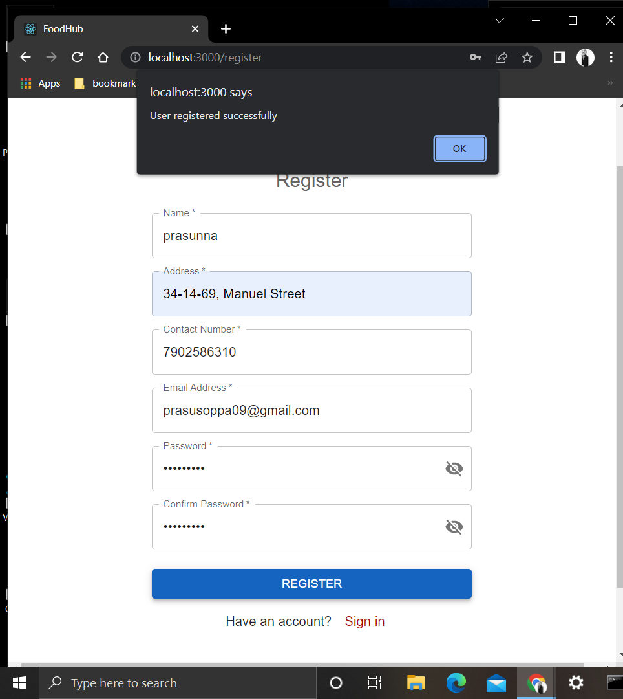
Registration/Login of User

Slide 6
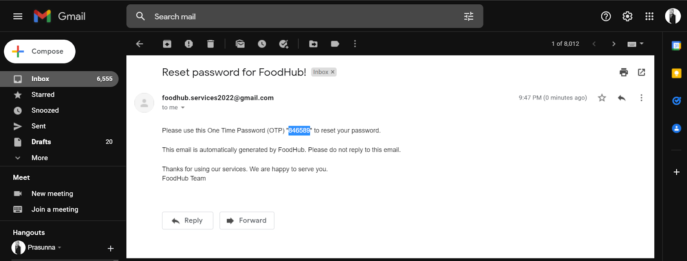
Forgot Password

Slide 7
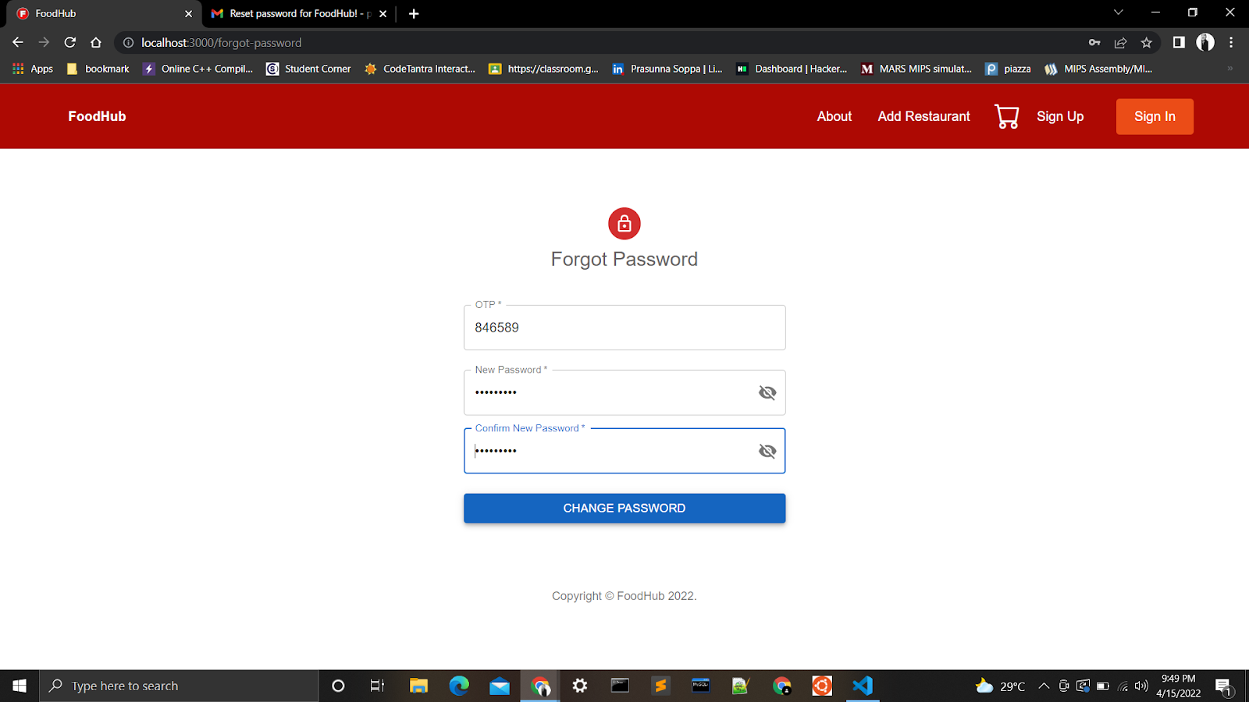

Slide 8
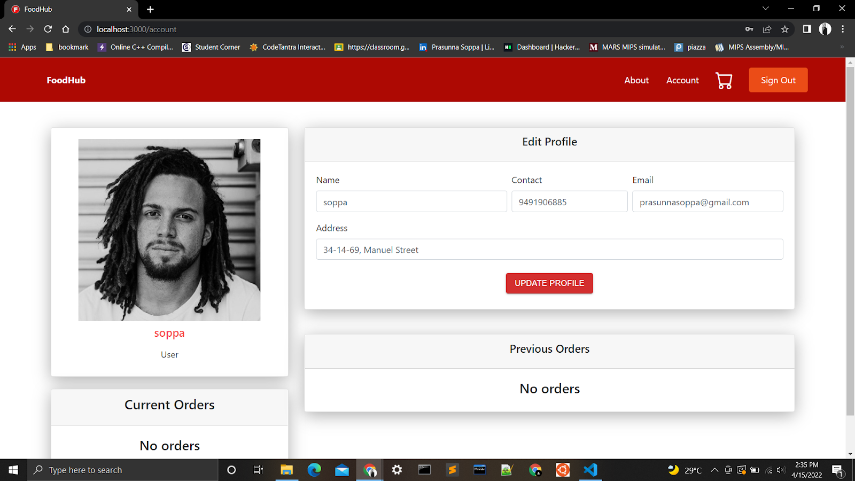
Editing User credentials

Slide 9
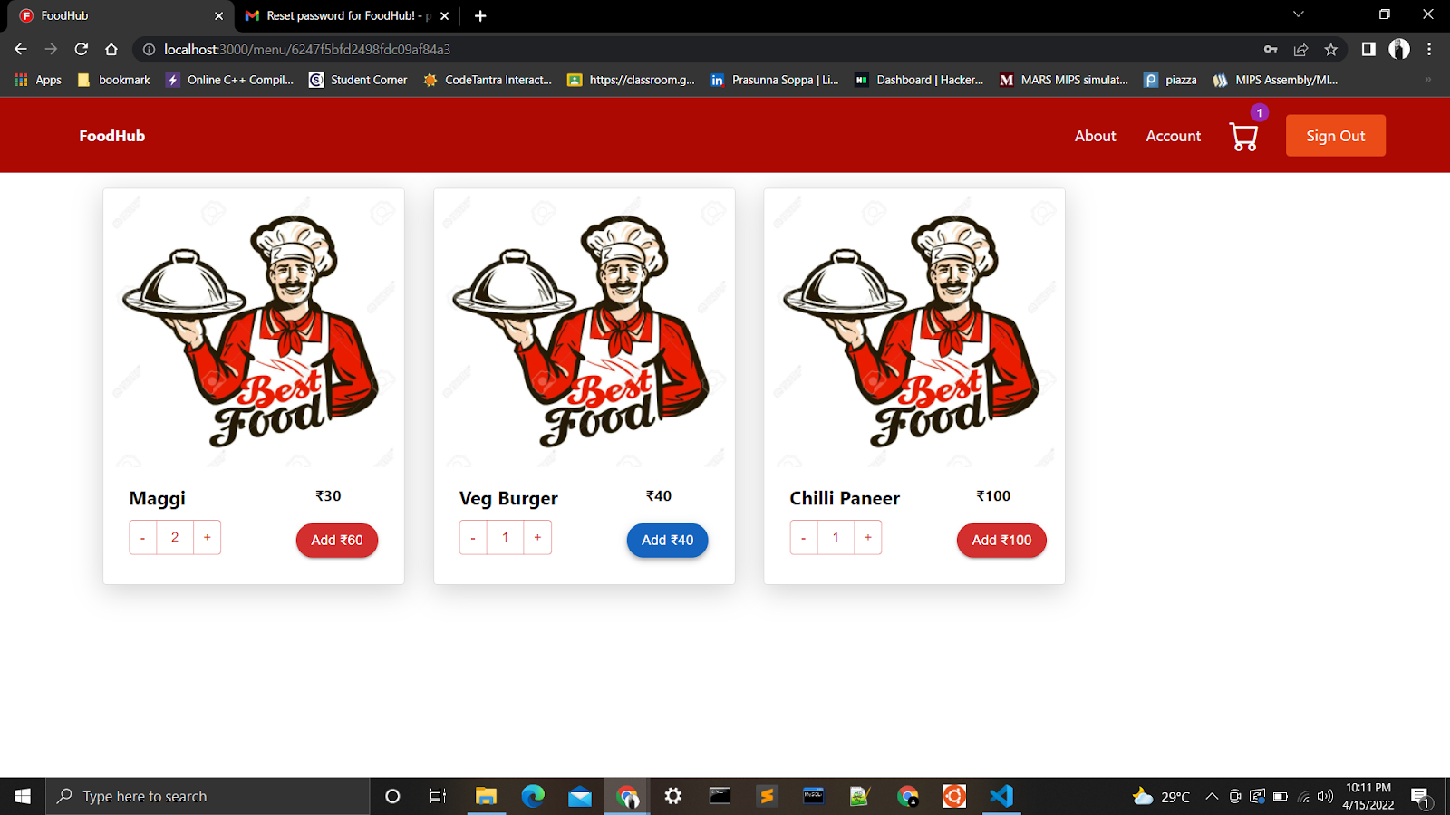
View Food Stalls and respective Menu

Slide 10
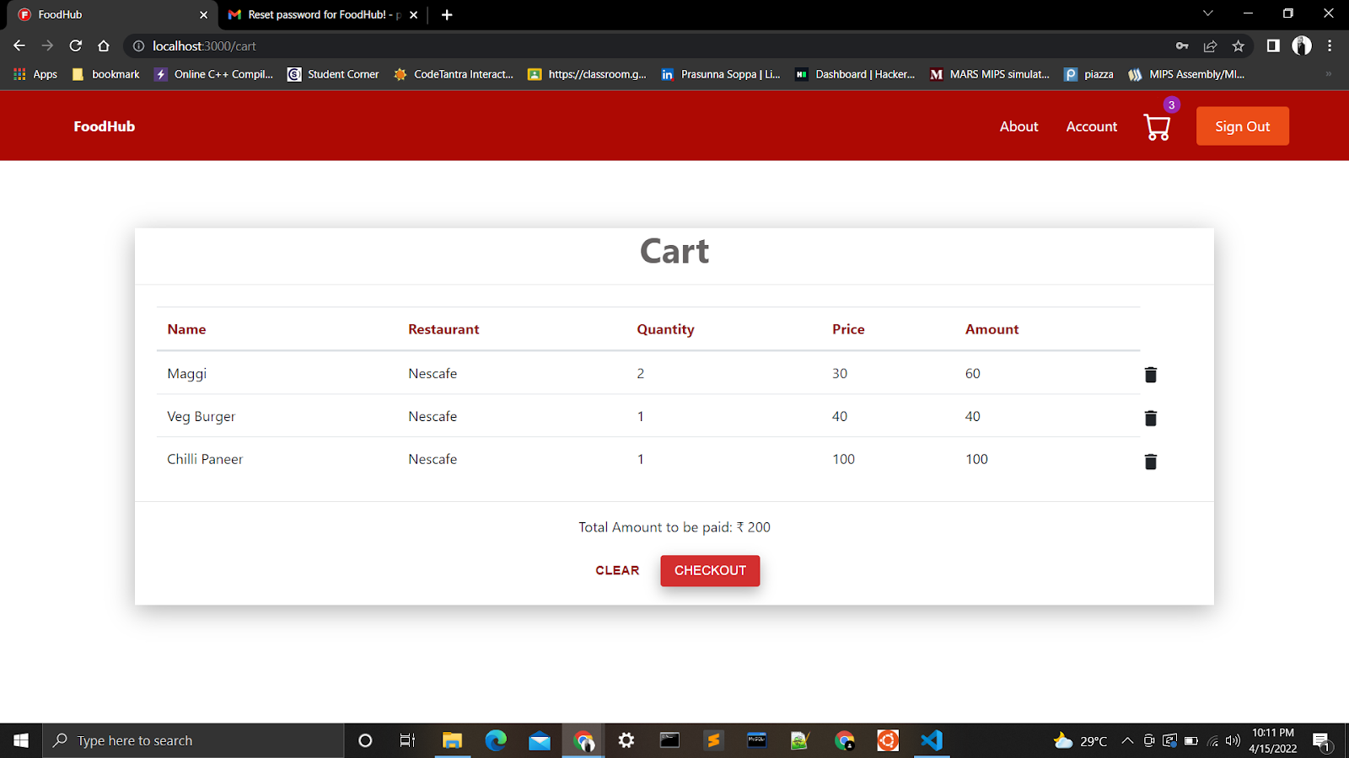
Place Order

Slide 11
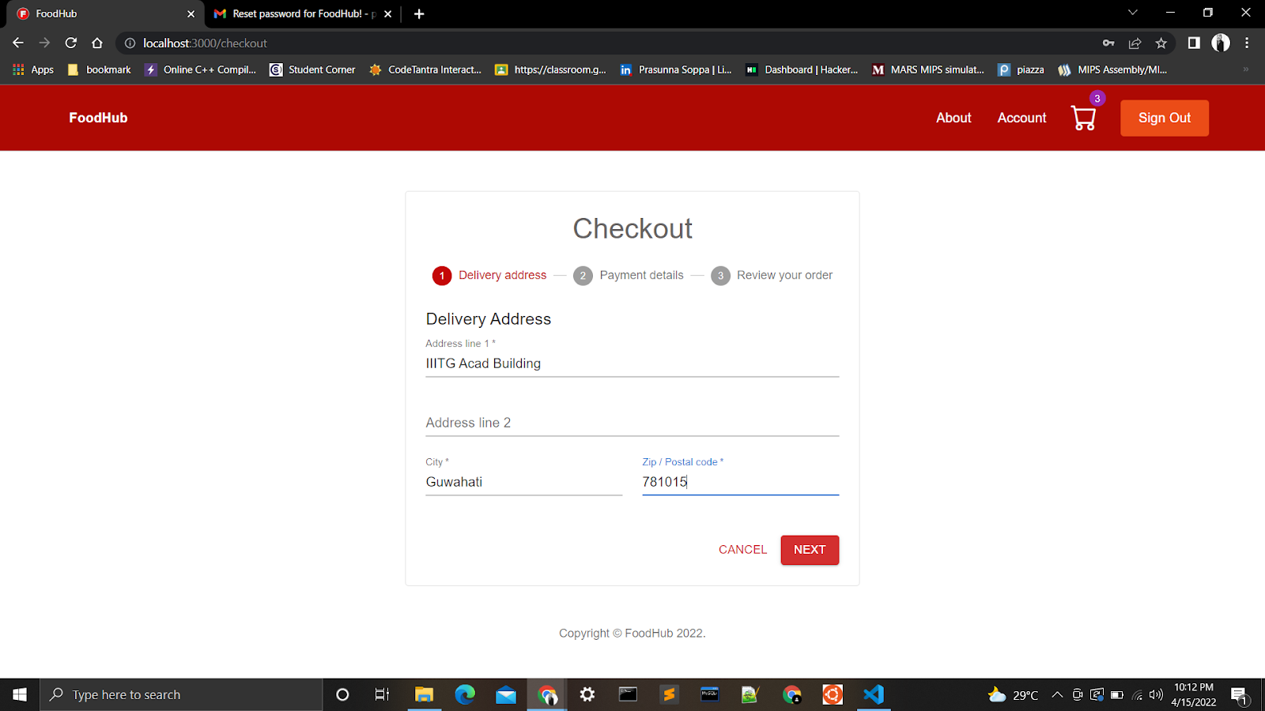

Slide 12
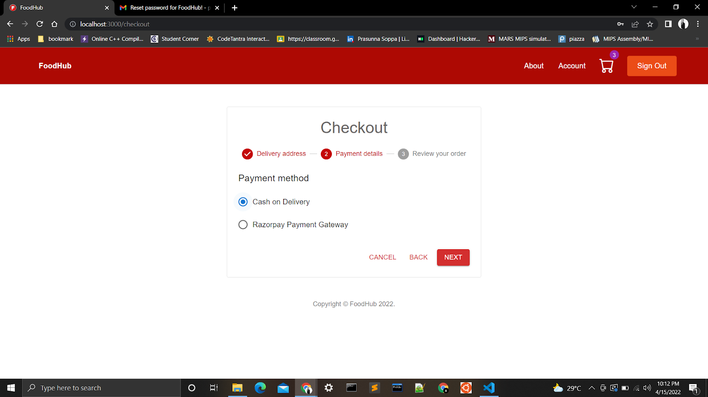
Payment (Cash On Delivery)

Slide 13
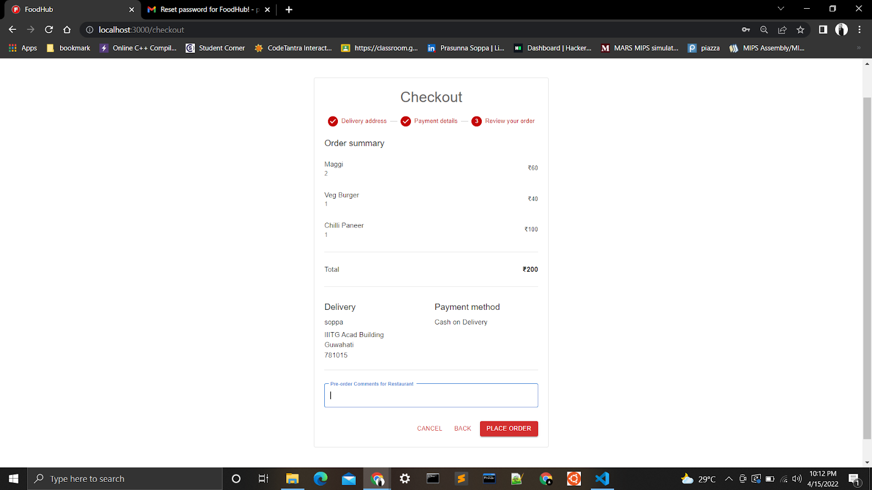

Slide 14
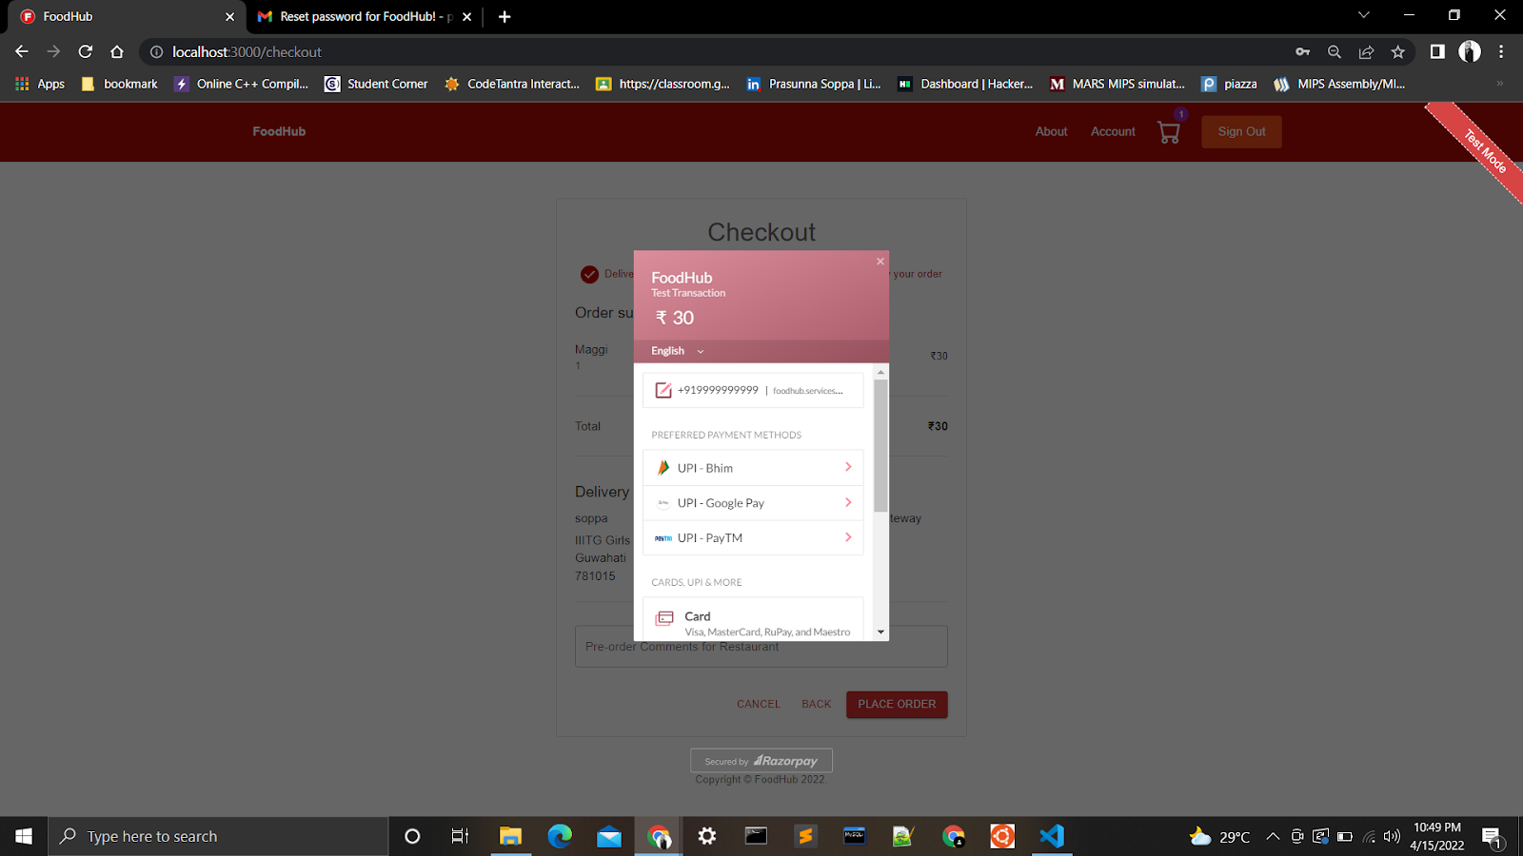
Payment(RazorPay)

Slide 15
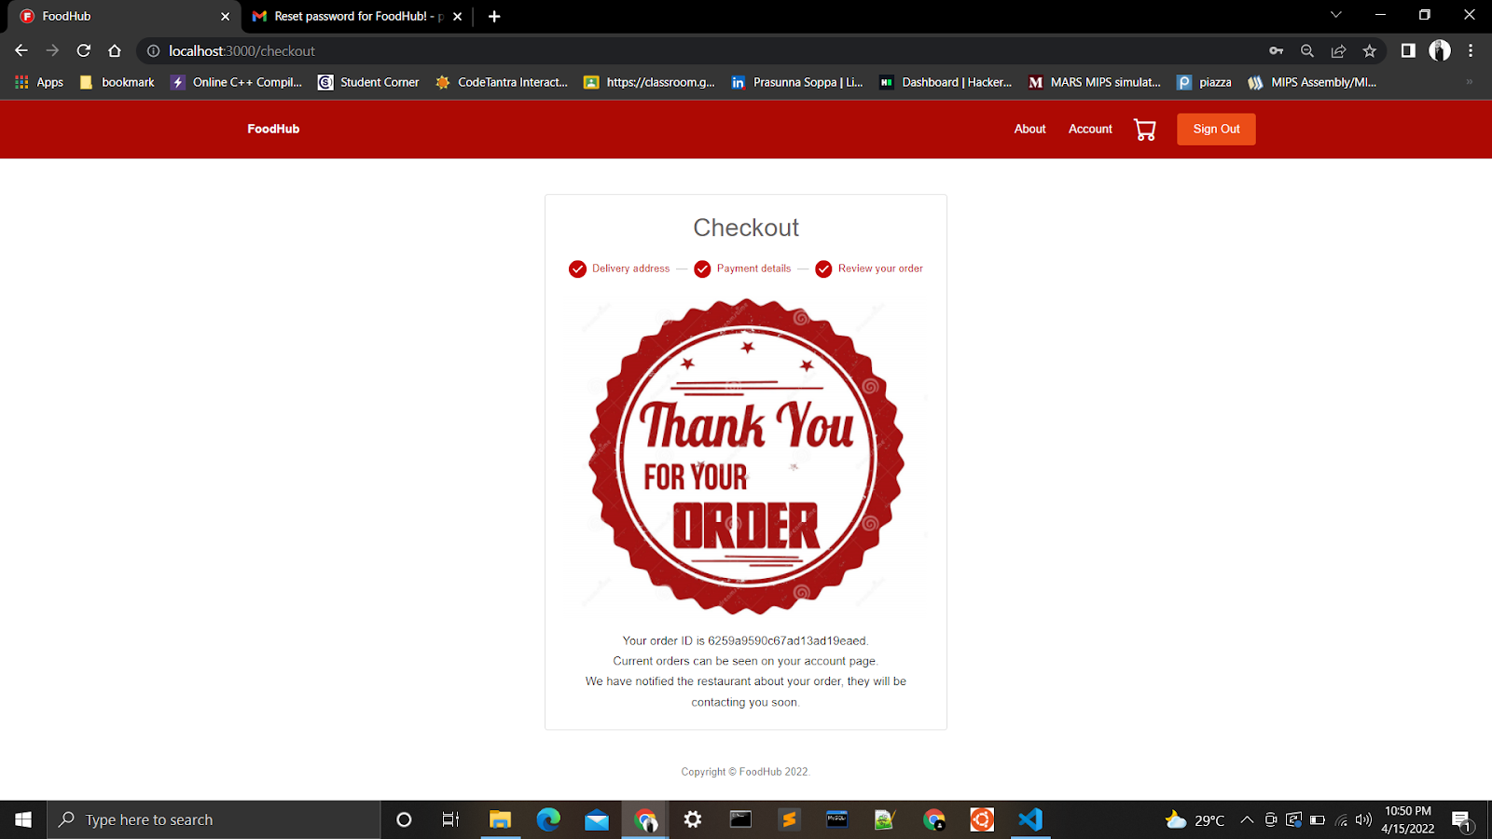

Slide 16
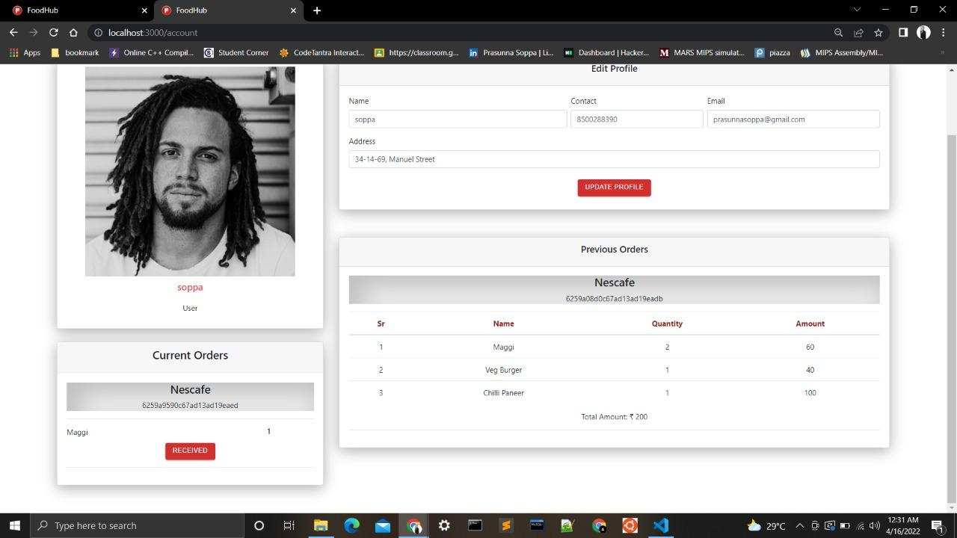
View Previous Orders

Slide 17
Functional
Requirements
Registration
Login/SignUp
Forgot Password
Modify Menu
View Current Orders
View Past Orders
RESTAURANT

Slide 18
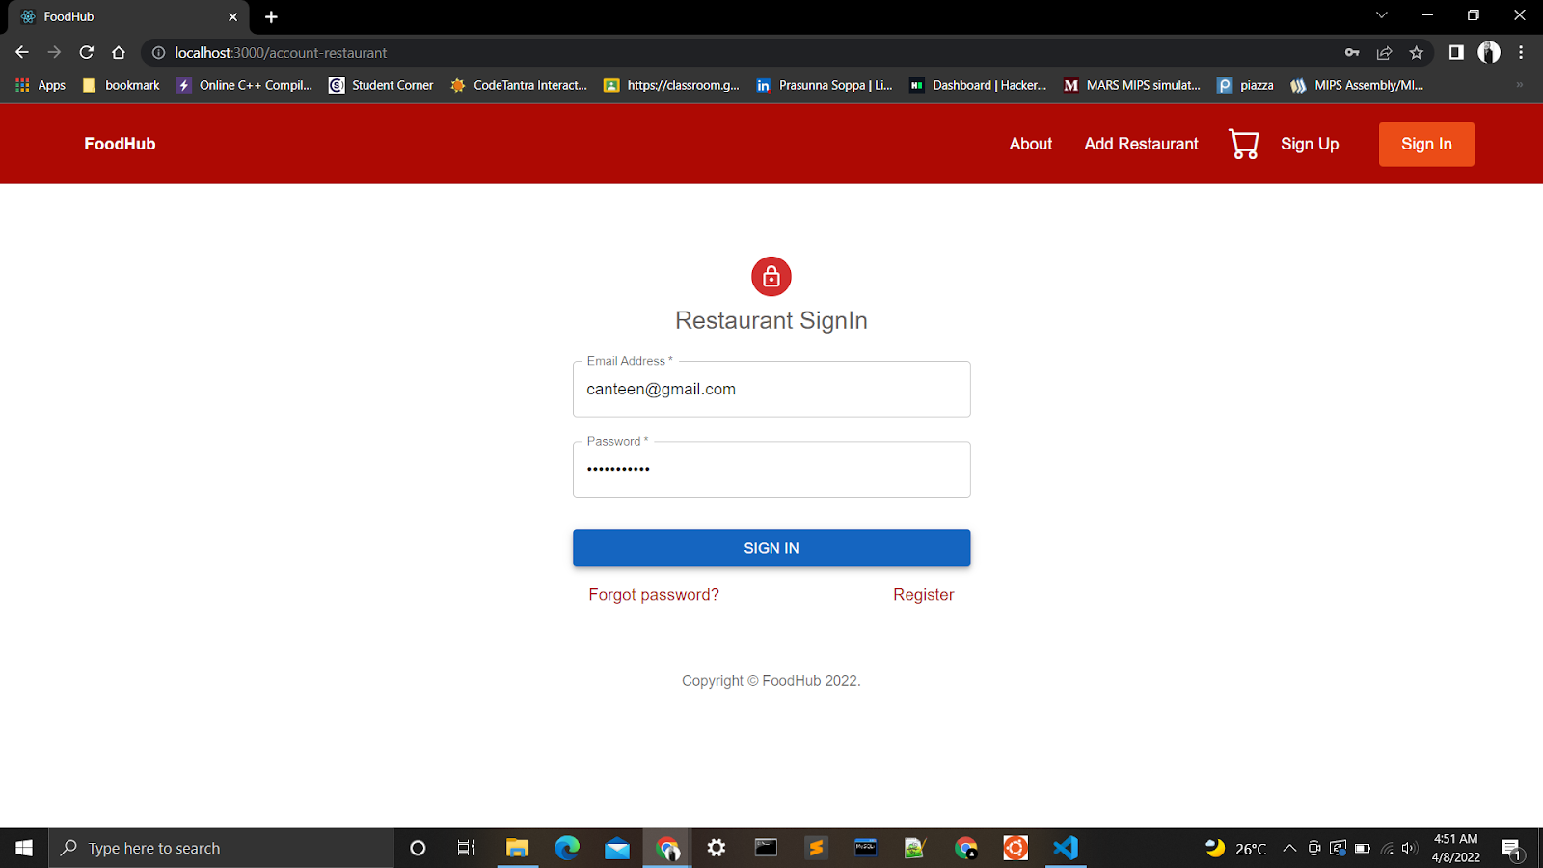
Register/Login as Restaurant

Slide 19
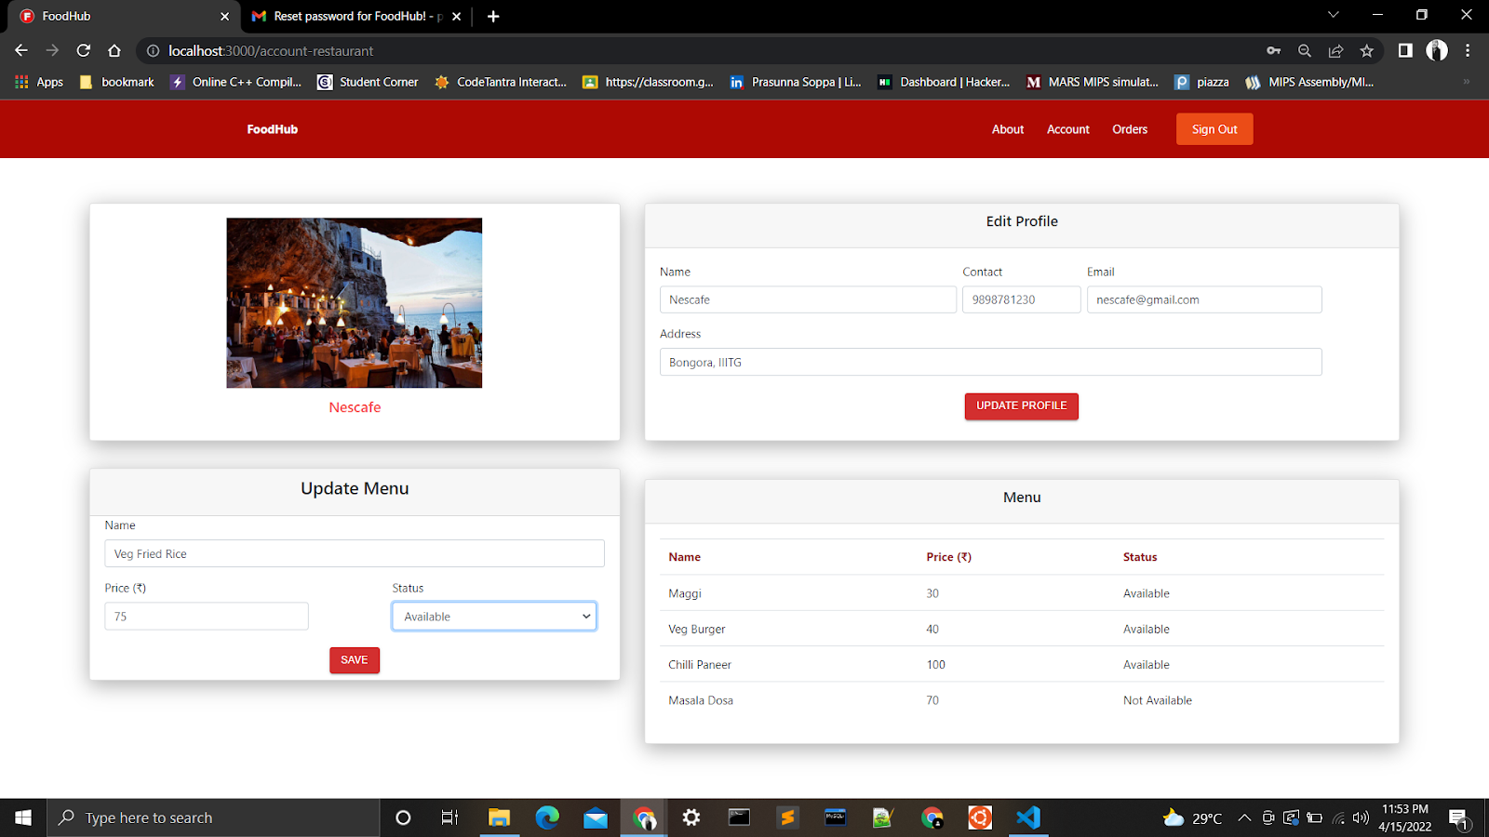
Modify Menu

Slide 20
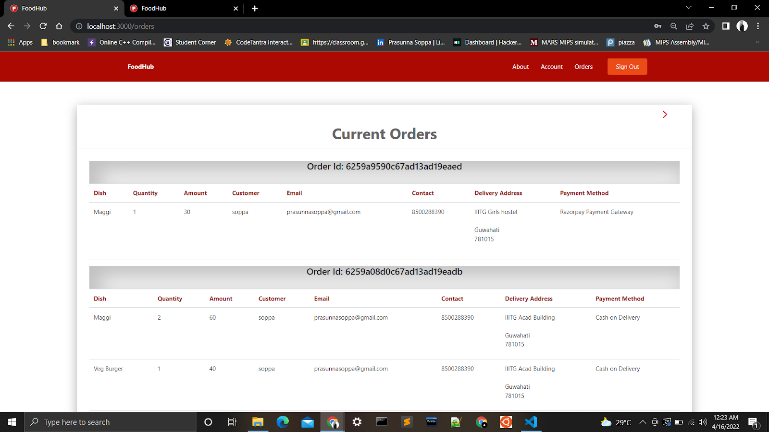
View Current Orders

Slide 21
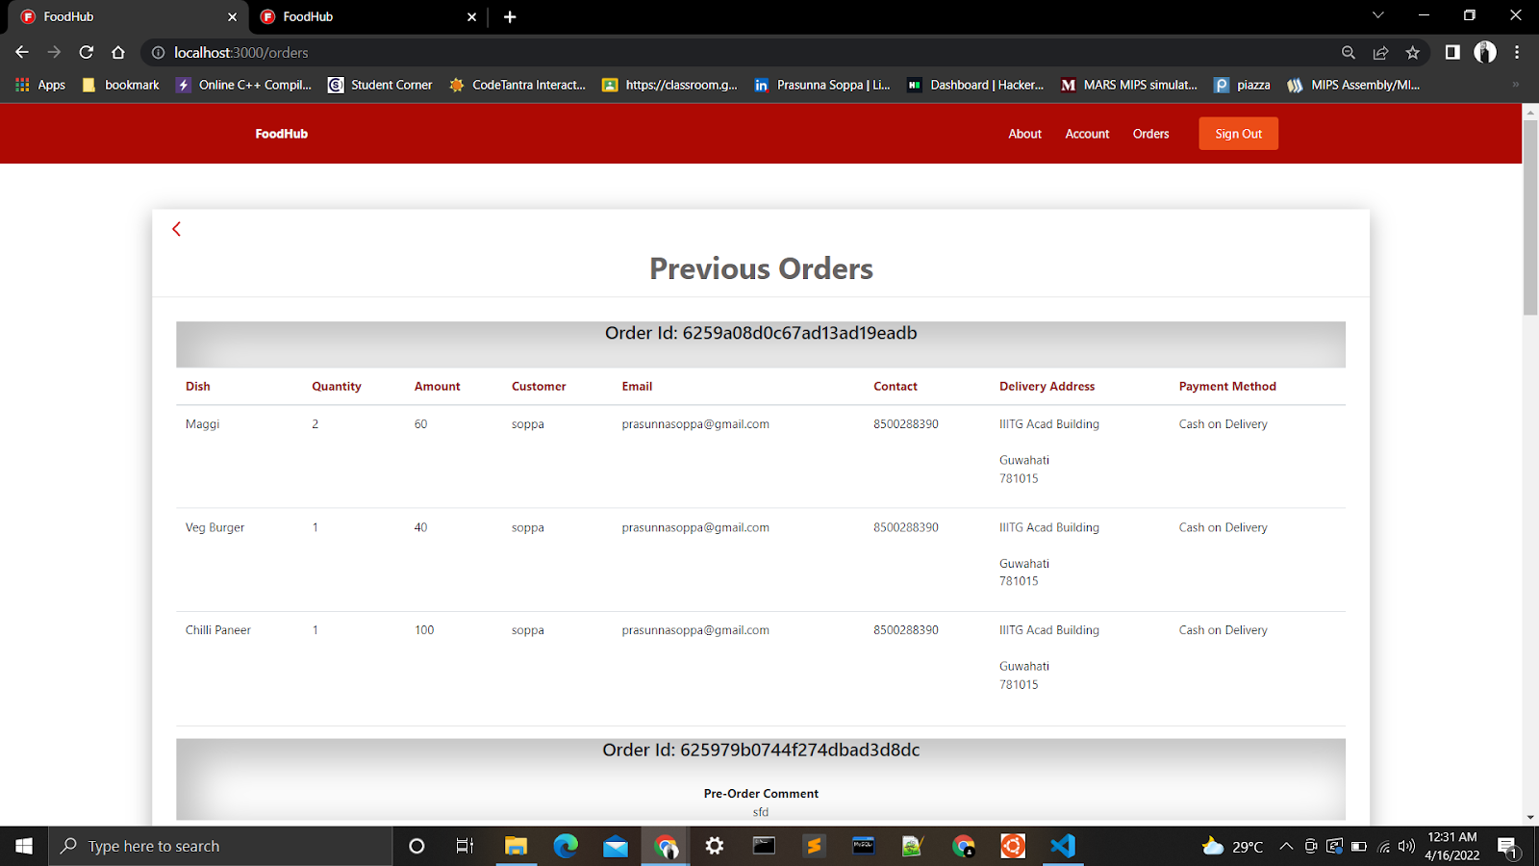
View Previous Orders

Slide 22
NonFunctional
Requirements
Responsive
User Friendly
Privacy
Security

Slide 23

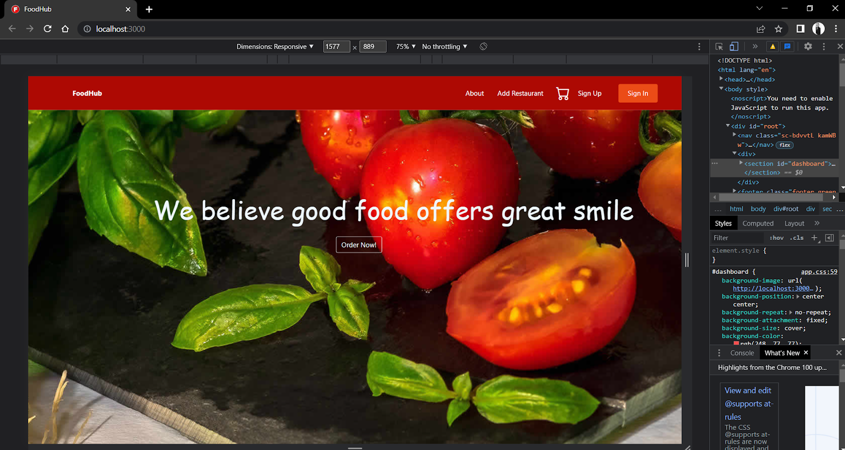
Responsiveness

Slide 24
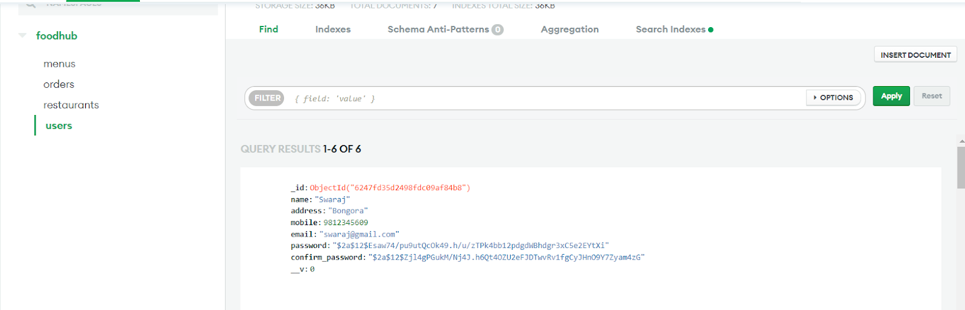
Privacy and Security

Slide 25

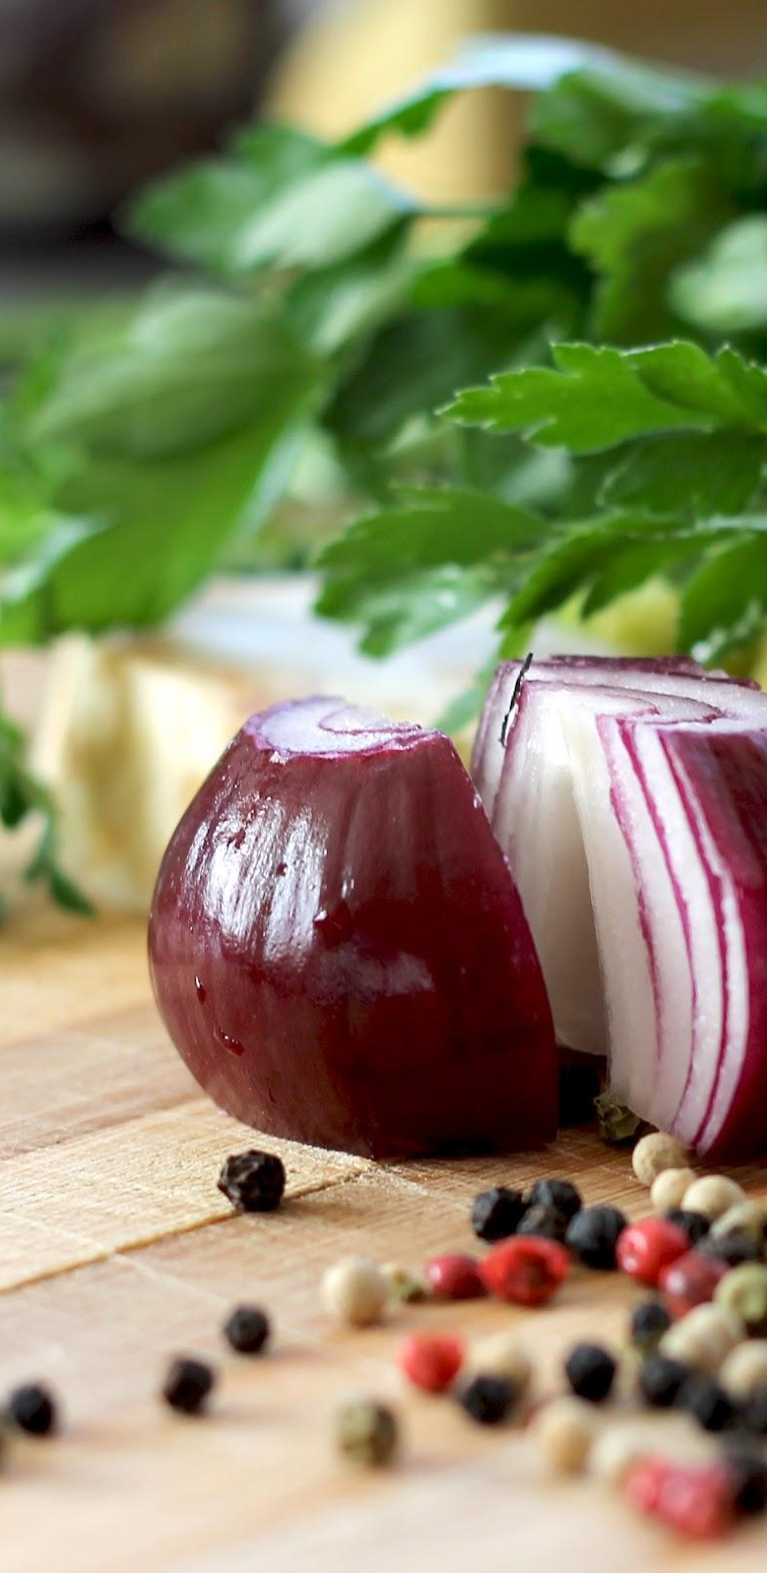
THANKYOU

